Slide 1
Study Chemical Engineering (or just Engineering) in Colleges and Universities
(Jason) Zhenyu Huang, PhD
AIChE Apprentice Program
January15 2013

Slide 2
The Importance of B. S. Chemical Engineering
Chemical Engineering B. S.
Graduate School
Industry
Education
Business/Law
Generally, a outstanding training of chemical engineering at bachelor level can make you
Choose between top-ranked graduate schools
More competitive in the job market

Slide 3
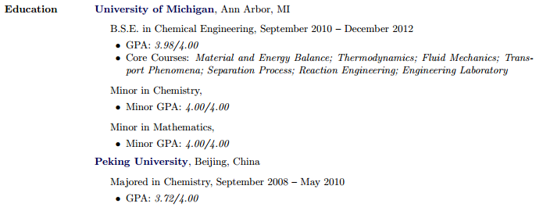
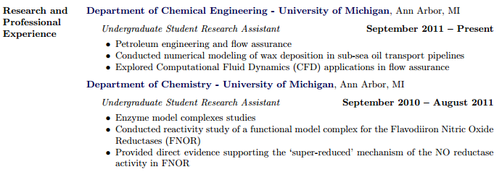
Question 1: Who do you want to be after <4 years?

Slide 4

Time Management – The Easy yet Difficult Task
“Managing time is the easiest type of management . You do not have to say nice things to your teammates and be careful not to hurt them because they are just hours or minutes. Of course you just need to make to make sure that you are not the one that prevents the execution of the plan”
It is all about being proactive…

Slide 5
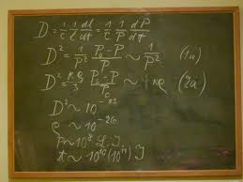
Studying Efficiency 1: Fully Utilize In-Class Time
Take notes
Not to doze off
Actively follow the instructor’s thoughts
Where is he/she going at
Does it make sense?
Equations
Identify the known and unknowns (how can I use this equation)
Identify the units of each parameter
Identify the trends of the variables

Slide 6

Studying Efficiency 2: Fully Utilize Off-Class Time
Most of the study is done off - class
Make a big difference on grades
Go – over lecture notes
Do not just read
Try the best to remember what you learn
Master them like you are to teach the class
Develop Engineering Common Sense:
Velocity of a motor vehicle = 650 mph ???

Slide 7

Working Group Projects
Group projects can be
You cannot fire your lame teammates, nor can you cur their salary.
You can try not to let them jeopardize your GPA by doing/improving some/all of their work. In this case you will probably learn more.

Slide 8
Graduate School
What one usually gets out (at least) from graduate school:
In-depth training of fundamental theories/advance experimental techniques related to one or several disciplines.
Multiple journal publications as well as conference presentations that make you one of the experts in the field
What can one actually get out from graduate school:
An amazing reading speed that make you to pick up things rather quickly
An attitude of “it is always good to learn something new” so that you keep an open mind and have a very wide comfort zone by using Wikipedia on a daily basis , if not hourly
A critical thinking that makes you not only realize that existing knowledge is far from perfect and there is a lot room for improvement but also learn to pick the suitable battles to fight
A habit of using methodical, systematic approaches that helps you make rational decisions not only on academic research, but also on financial investment and career decisions. (might want to hide that habit a bit during dating…)

Slide 9
Thank You!

